Slide 1

H₂HOME
“Hassle-Free Hydration at Your Doorstep”

Slide 2
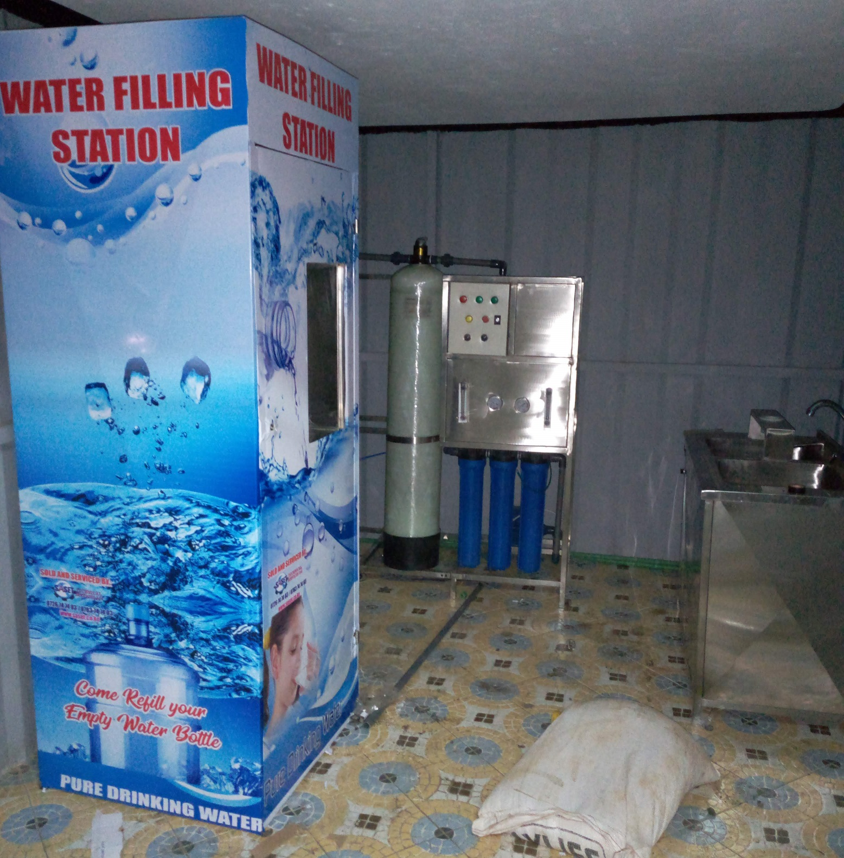
PROBLEM STATEMENT
In urban areas like Juja, many residents lack convenient access to fresh drinking water, forcing them to manually visit local vendors multiple times a week.
This process is time-consuming, inconvenient, and inefficient, with no streamlined way to track water consumption, locate nearby vendors, or schedule reliable deliveries.

Slide 3




SOLUTION
H₂HOME:
-An IoT based software that automates and track the delivery of drinking water from the local vendors to consumers as well as monitoring the customers water consumption.

Slide 4



CORE FEATURES
Water consumption monitoring:
Users can be able to track their water consumption rate through the software.
Vendor Listing:
The users will be provided with a list of local vendors within their area to choose from.
Automated Water Delivery:
Customers will receive drinking water at their doorsteps at their convenience

Slide 5


REVENUE GENERATION
Monthly Subscription
An automated algorithm will also be used to calculate a customer's subscription amount based on their desired water quantity and number of refills per month.
Pay-As-You-Go (PAYG) Option
For customers who don’t want a subscription, they can pay per refill at a slightly higher rate:

Slide 6

TARGET MARKET
Our target market is urban apartment residents in areas with limited access to fresh drinking water, who seek a convenient, reliable, and efficient way to order and track water deliveries from local vendors.

Slide 7
PROJECT ROADMAP
Phase | Tasks | Timeline
Design and Planning | Requirement Fits | Feb 10 – Feb 17
 | Design and Planning | Feb 17 – Mar 3
 | Monitoring | Mar 10 – Mar 13
Development | Frontend Development | Feb 20 – Mar 31
 | Backend Development | Mar 2 – Mar 31
 | IoT Development | Mar 12 – Mar 31
 | Payment Integration | Mar 31 – Apr 7
Maintenance | Maintenance | Apr 14 –
Data Analysis | User Data Analysis | Mar 31– Apr 23
Quality Assurance | Training and Feedback | Mar 9 – Mar 15
Project Completion | Process Review and Hardware | 2026

Slide 8

Thanks!

